Slide 1
Introduction

Slide 2
About the Course
CS6501: Vision and Language
Instructor: Vicente Ordonez
Email: vicente@virginia.edu
Website: http://www.cs.virginia.edu/~vicente/vislang
Location: Thornton Hall E316
Times: Tuesday - Thursday 12:30PM - 1:45PM
Faculty Office hour: Tuesday 3 - 4pm (Rice 310)
Discuss in Piazza:piazza.com/virginia/spring2017/cs6501004

Slide 3







About Me
Assistant Professor 2016 - Now
Researcher 2015 - 2016
MS, PhD in CS,
2009-2015
… also spent time at:

Slide 4
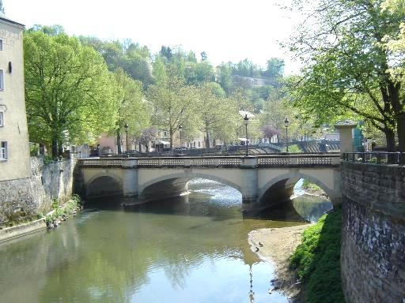
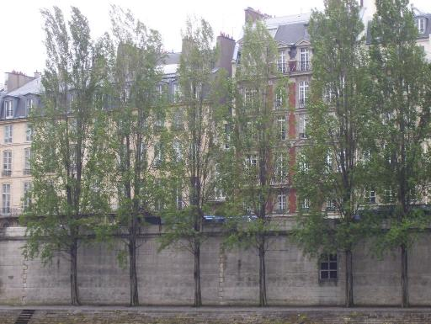
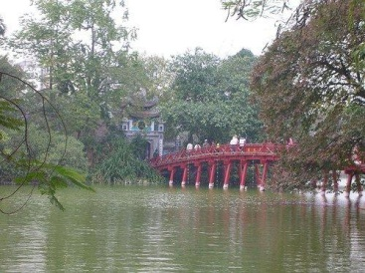
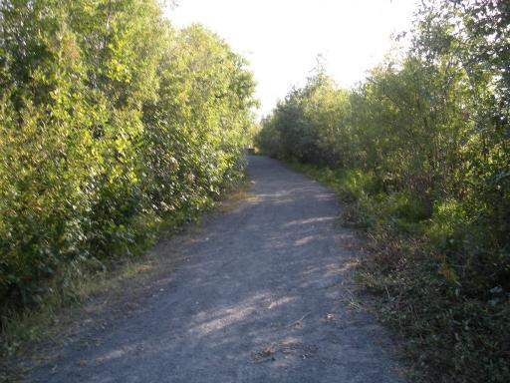
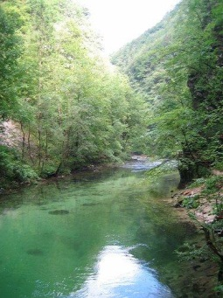
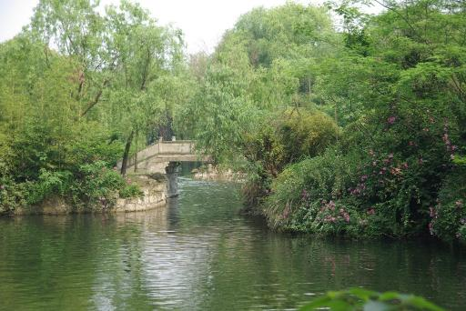
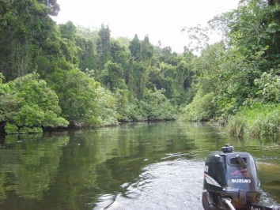
Im2Text
Matching using Global Image Features (GIST + Color)
Millions of samples
Smallest house in paris between red (on right) and beige (on left).
Bridge to temple in Hoan Kiem lake.
A walk around the lake near our house with Abby.
Transfer Caption(s)
The water is clear enough to see fish swimming around in it.
Hangzhou bridge in West lake.
The daintree river by boat.
e.g. “The water is clear enough to see fish swimming around in it.”
. . .

Slide 5
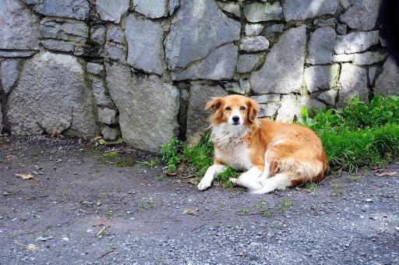
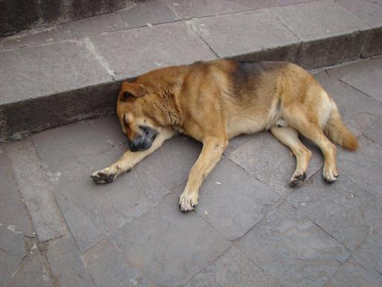
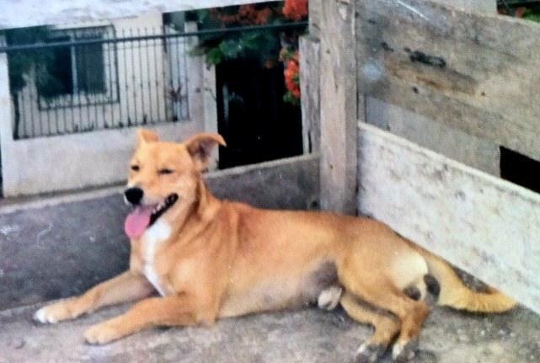
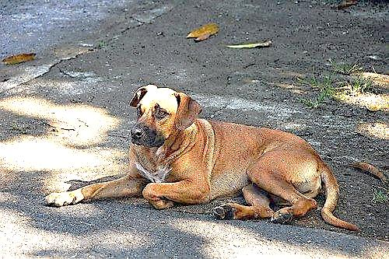
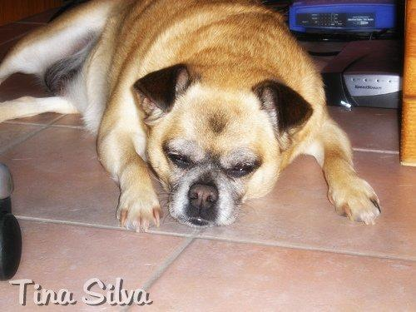
Retrieving verb phrases from similar object detections
Contented dog just laying on the edge of the road in front of a house..
Peruvian dog sleeping on city street in the city of Cusco, (Peru)
Detect: dog
Find matching dog detections by visual similarity
this dog was laying in the middle of the road on a back street in jaco
Closeup of my dog sleeping under my desk.
Notes:
Similarly we can retrieve verb phrases based on similar matching poses. For example giving us – laying on the edge of the road in front of a house.

Slide 6
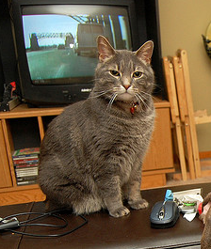
Large Scale Image Classification and Entry-Level Categories
Abyssinian cat
Angora cat
domestic cat
tabby cat
mammal
Rottweiler
Machine Learnig Model
dog, Canis familiaris
bulldog
animal
King penguin
penguin
seabird
Cormorant
bird
Frog orchid
orchid
daisy
flower
plant, flora
daffodil
entry-level categories

Slide 7
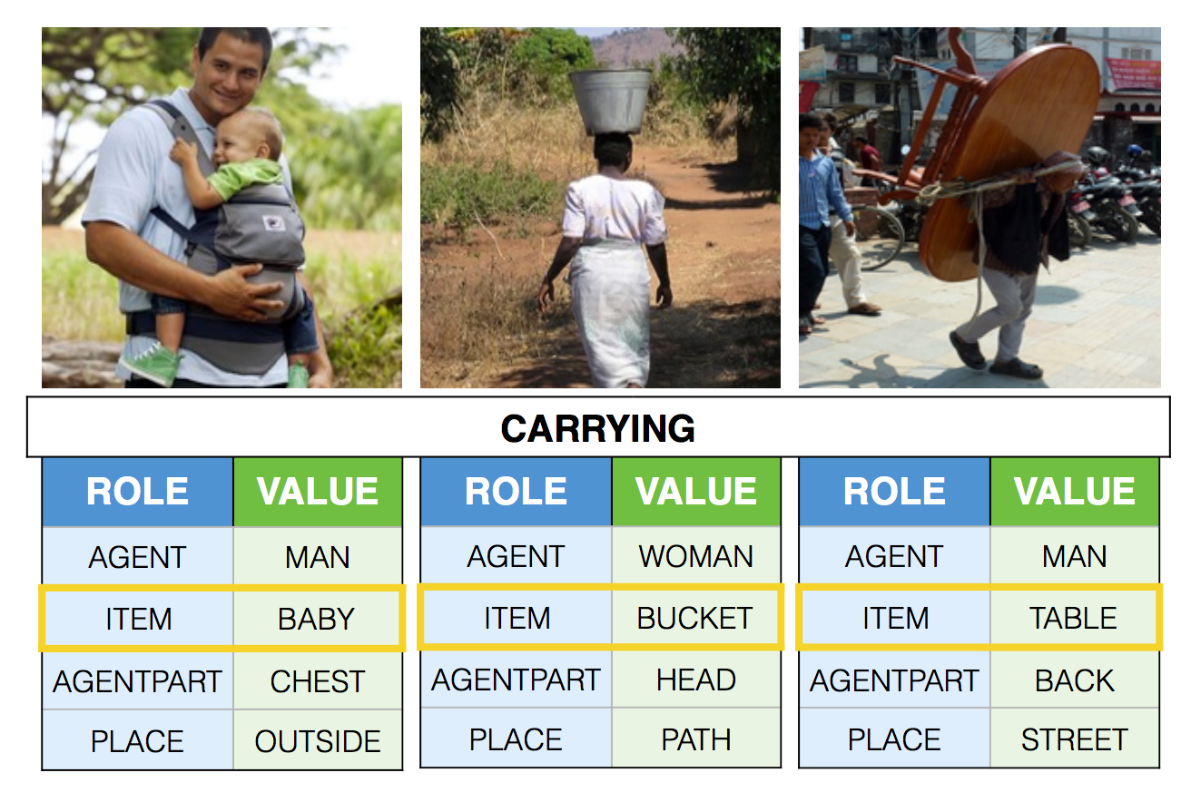
Situation Recognition
Demo http://imsitu.org/demo/

Slide 8
Objectives
Acquire the basic background to follow research at the intersection of Vision and Language.
Obtain an Overview of the Research Trends at the intersection of Vision and Language.
Acquire the skills to design a non-trivial machine learning / deep learning model for a vision and language problem.

Slide 9
Pre-requisites
Background in Machine Learning.
Python programming skills (or willingness to learn the language)
Calculus / Linear Algebra / Probability
Helpful
Background in Computer Vision (and / or)
Background in Natural Language Processing

Slide 10
Additional Requirement
GTX Pascal Titan X (12GB): $1,2000
GTX 1080 (8GB): $600
GTX 1070 (8GB): $400
GTX 1060 (6GB): $250
Or…

Slide 11
Additional Requirement
g2.2xlarge: 4GB ($0.65 / hour)
p2.xlarge: 12GB ($0.90 / hour)
Free credits for students! $50.

Slide 12
Grading Criteria
Project (50pts)
Labs (30pts) [5pts + 5pts + 10pts + 10pts].
Student Paper Review / Participation (10pts)
Paper summaries (10pts)
An optional lab to replace the lowest grade in a Lab.
No late submissions

Slide 13
Grading Criteria: Project (50pts)
Project Proposal - Two-page PDF document. - Submit this document on UVACollab by February 21st. The earlier you define your project, the earlier you can start working on it.
Teamwork encouraged: Groups of size = 3 are highly encouraged.
Considerations for your project: Technical Depth: 15pts Creativeness: 15pts Meets Goals in Project Proposal: 10pts Project Report (min 4 to max 5 pages): 10pts (see format template for the report in course website)

Slide 14
Grading Criteria: Labs (30pts)
Python Jupyter Notebooks - Image Processing and Retrieval Lab (5pts) - Deep Learning Lab (5pts) - Language Generation Lab (10pts) - Image Captioning Lab (10pts)
Export notebook as HTML and submit on UVACollab.
Individual work.

Slide 15
Grading Criteria: Student Paper Review (10pts)
Need to present a recent research paper in the class.
Presentations will be in groups of three.
Pick a paper from the syllabus.
Some slots are open to suggestions, you pick the paper (contact the instructor)
Need to prepare slides, send them by email to instructor at least the day before the session.
Presentations should be carefully planned to only use 20 minutes.

Slide 16
Grading Criteria: Paper summaries (10pts)
Send an email with a quick summary of the papers that are going to be presented in the sessions named: Student Paper Review.
Summary must be concise but clearly show that you have read the paper, thus it should provide a summary and commentary. What are the strengths of this paper? How can it be improved?
Important: Send summaries to this email: visionlab.uva+summary@gmail.com

Slide 17
Teaching Assistants
Tianlu Wang
PhD Student Office Hours: Wednesdays 4 to 5pm.
Location: to be defined
Xuwang Yin PhD Student Office Hours: Mondays 4 to 5pm. Location: to be defined

Slide 18
Course Topics
Word Embeddings: Representing text.
Recurrent Neural Networks (RNN): Generating Text.
Convolutional Neural Networks (CNN): Object Recognition.
Generating Textual Descriptions for Images.
Learning from Images and Text on the Web.
Answering Questions about Images: Visual Question Answering.
Referring to Objects in Natural Scenes: Referring Expressions.
Video and Text alignment, Video Description.
Memory and Attention Networks.

Slide 19
Sample Project Topics
Generating image descriptions for images of merchandise.
Generating image storyboards from movie scripts.
Generating image slideshows from music lyrics
Summarizing video using help from text subtitles.
Beating Google Image Search at this query ”gray cat under white table”
Return wikipedia articles that could be related to an input image. (e.g. if the image is of a zebra, it should return, zebra, and other similar animals to zebra).
Make an app that inserts images to help convey your text message using pictures (similar to the way emoticons are used)

Slide 20
Outline for Today
Challenges in Computer Vision
Challenges in Natural Language Processing
Challenges in Vision + Language Systems

Slide 21
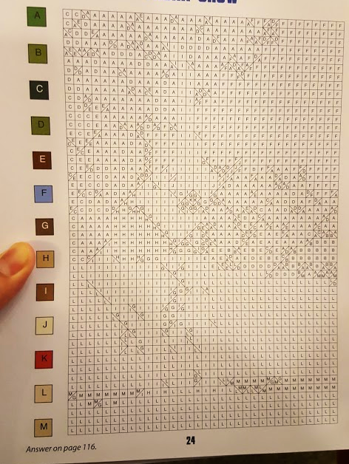
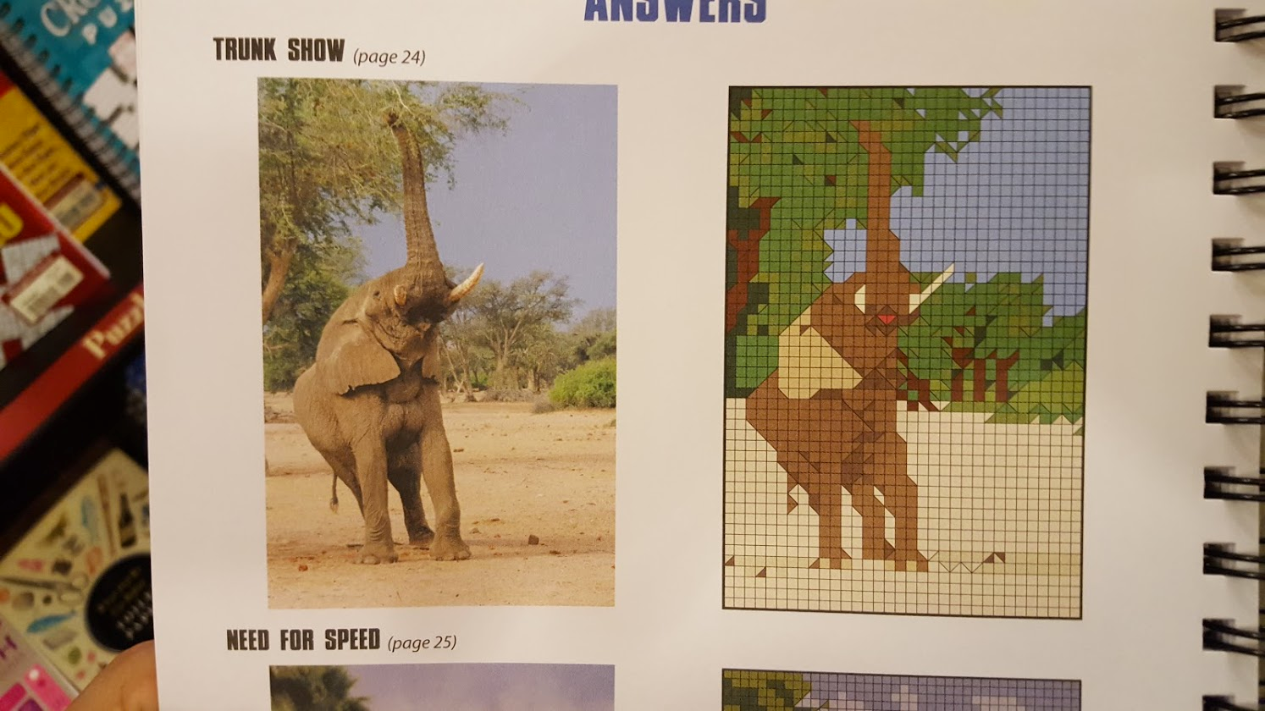
Challenges in Computer Vision

Slide 22
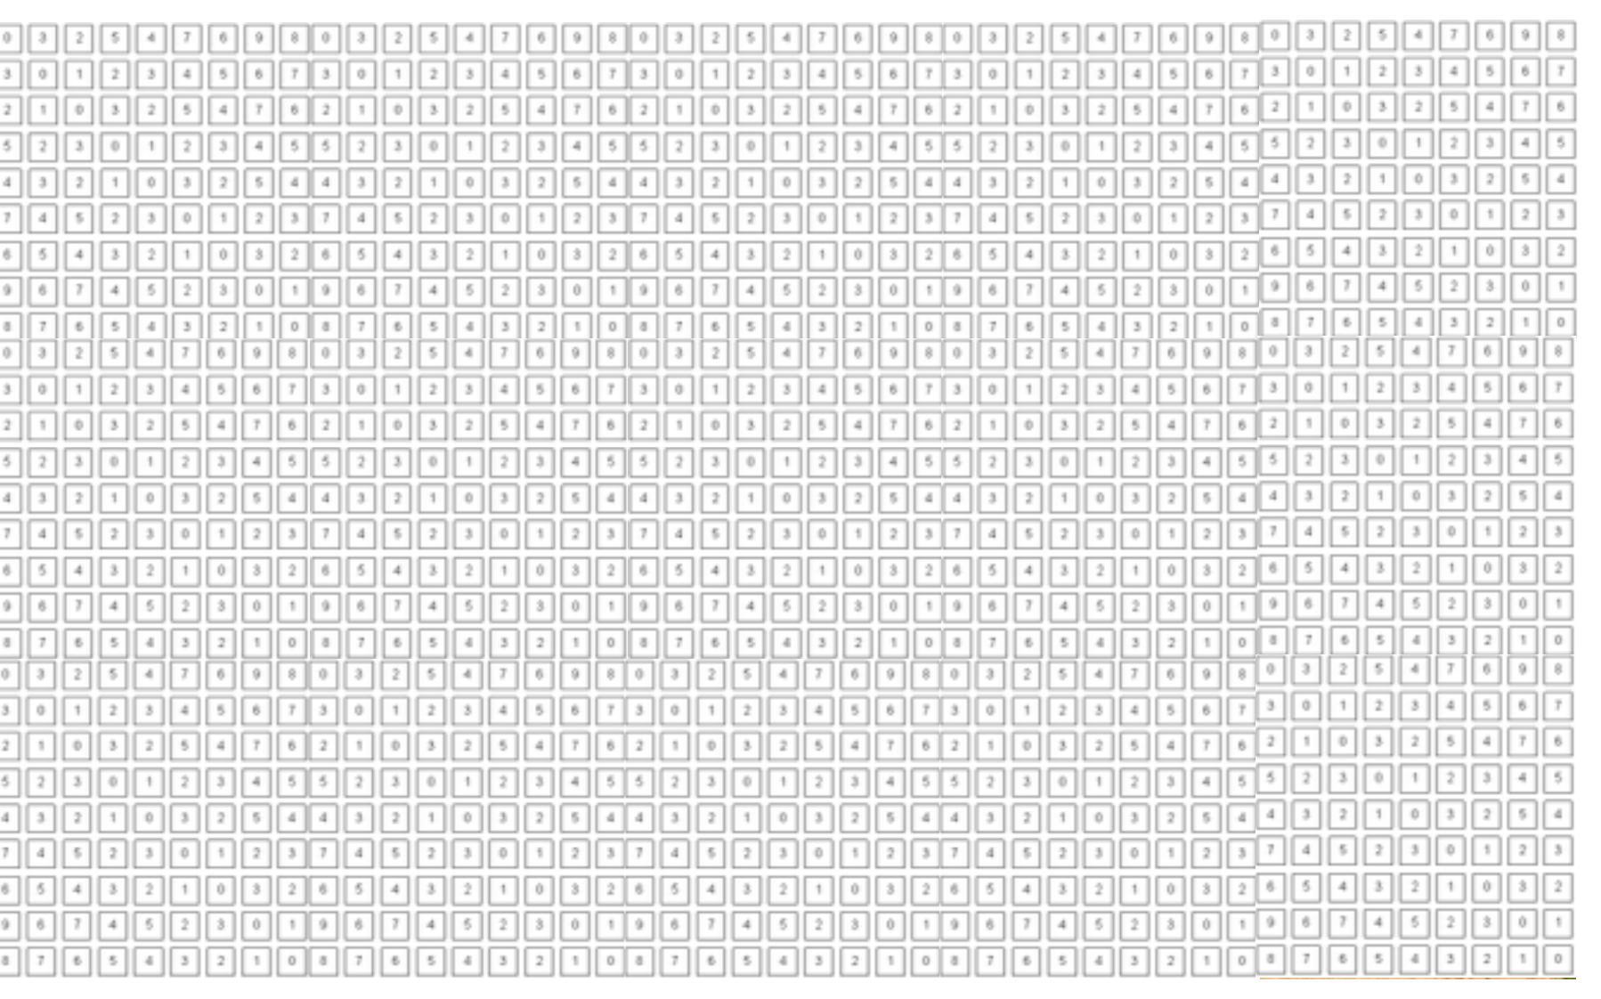
What a computer can really see:

Slide 23
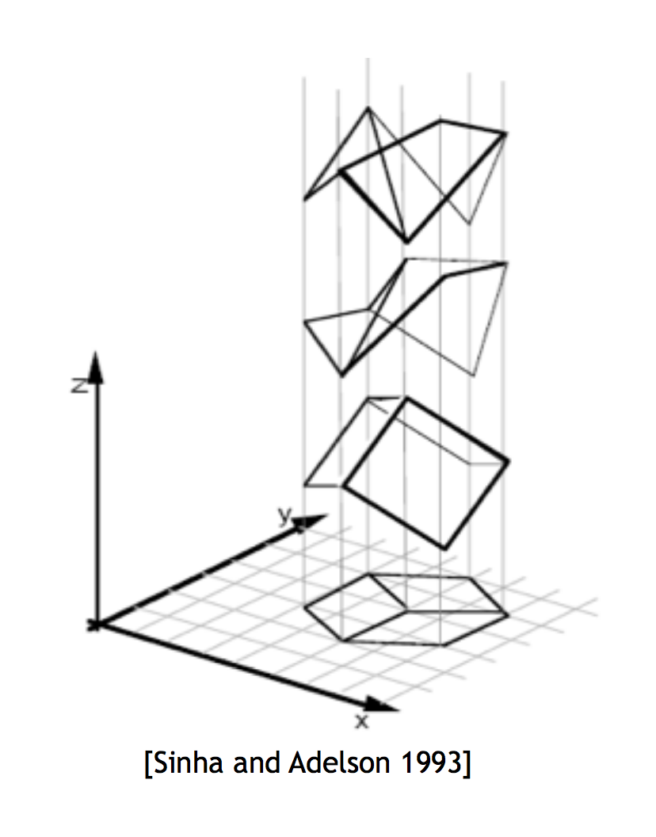

Slide 24
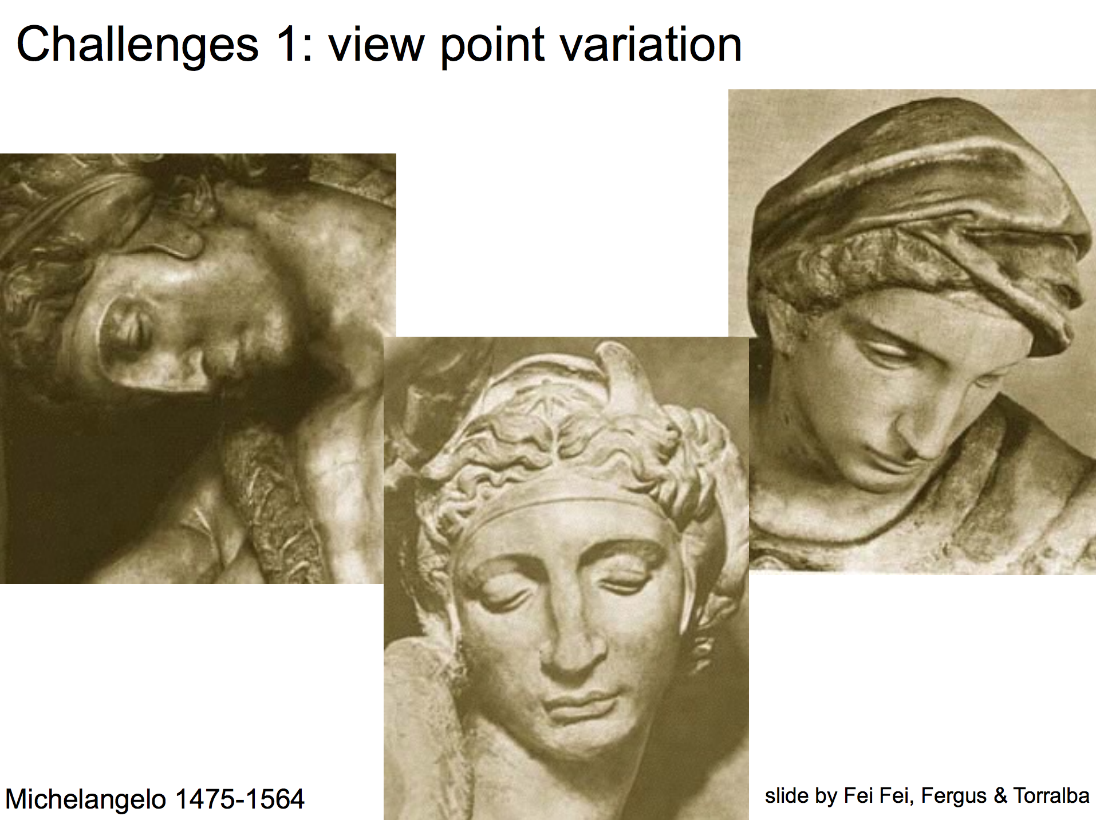
View Points

Slide 25
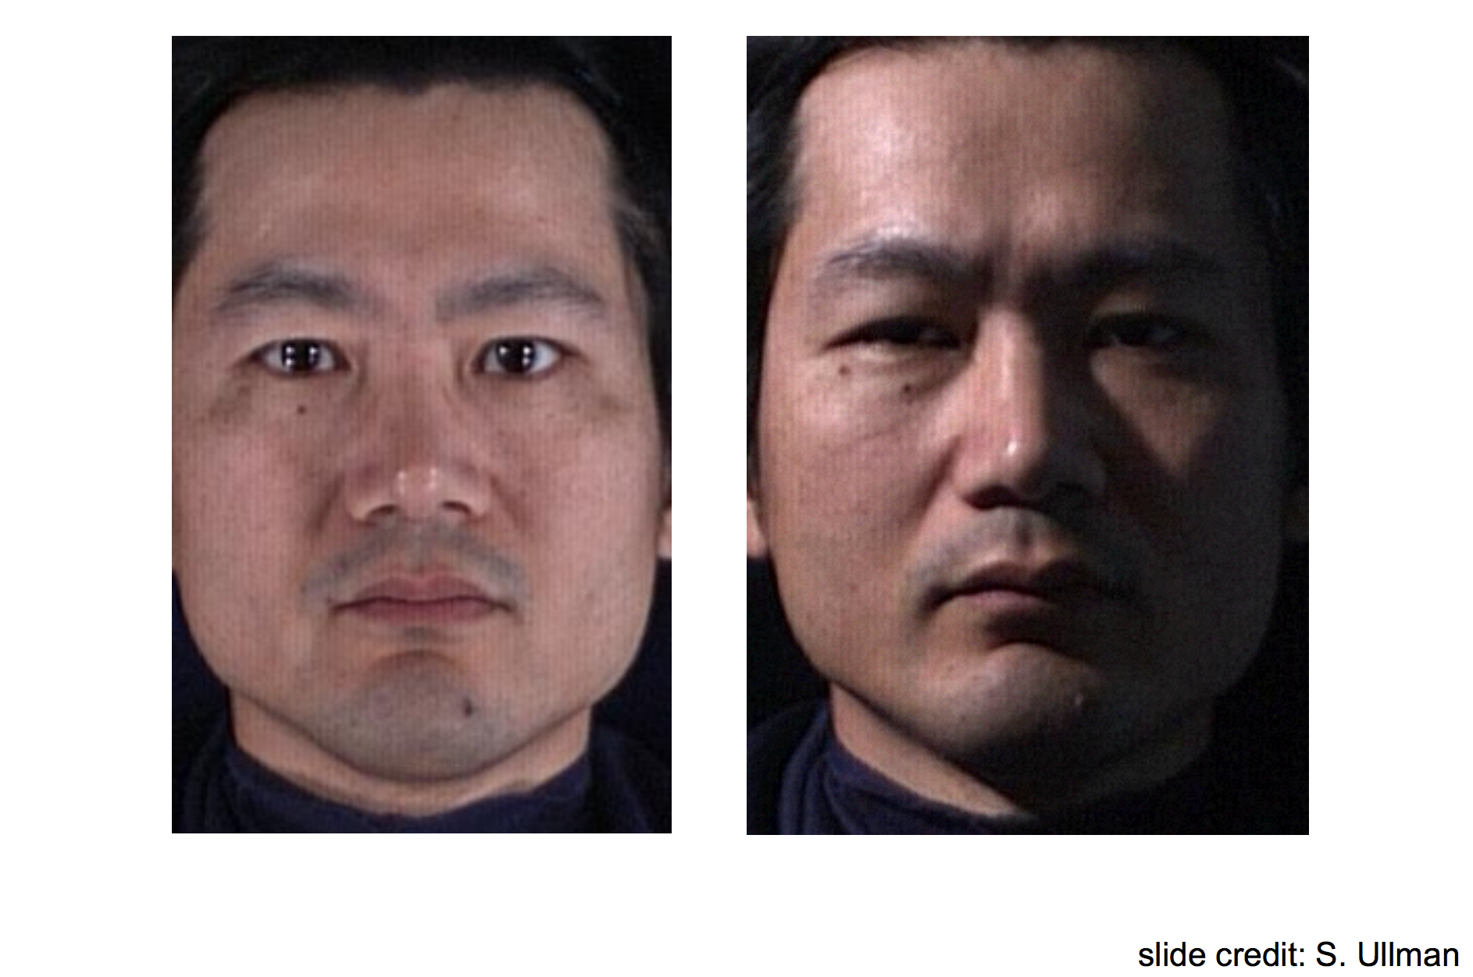
Illumination

Slide 26
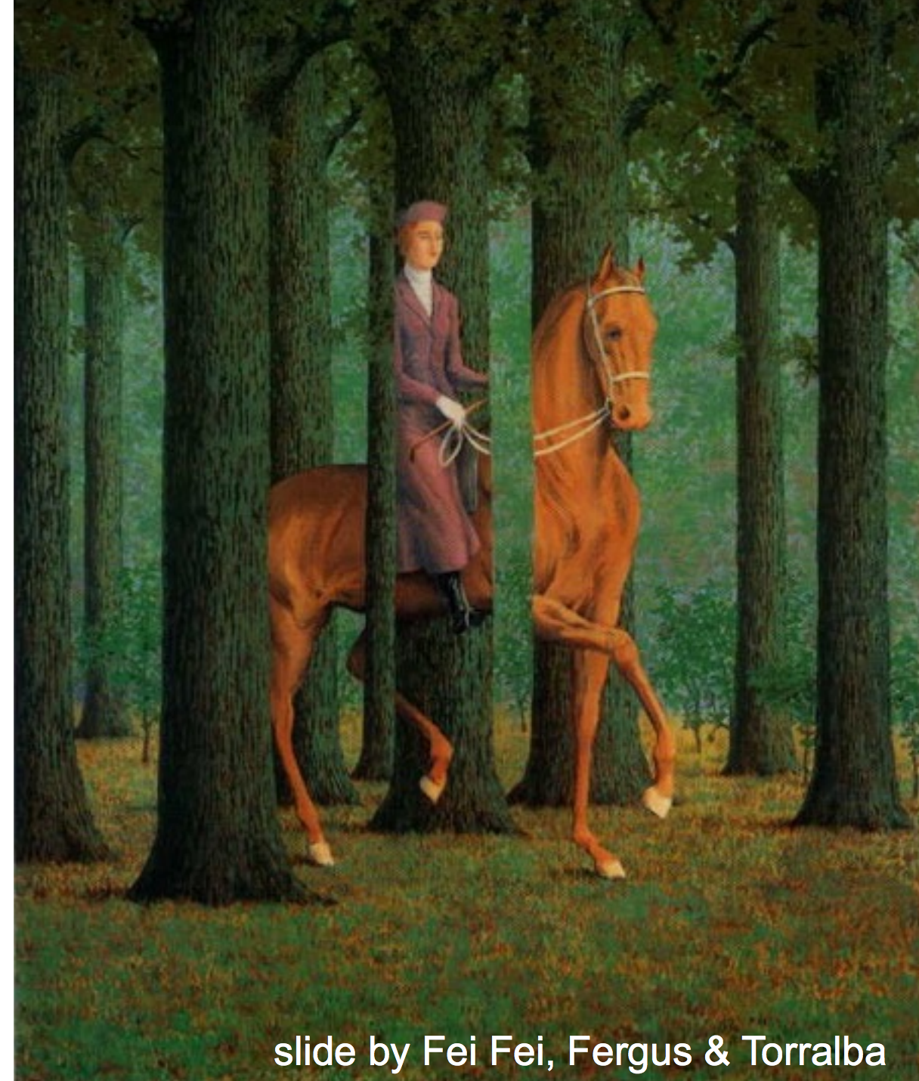
Occlusions

Slide 27
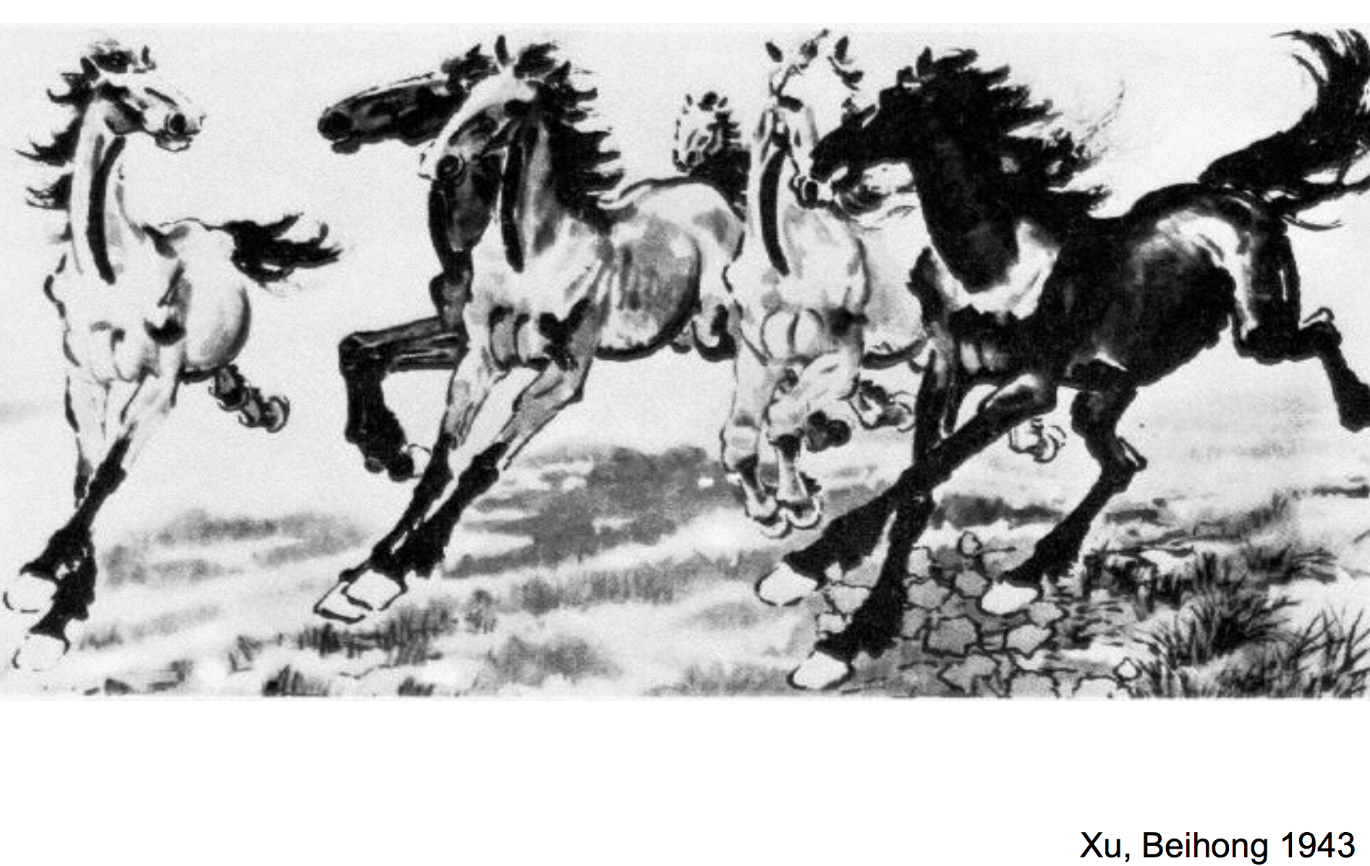
Deformation

Slide 28
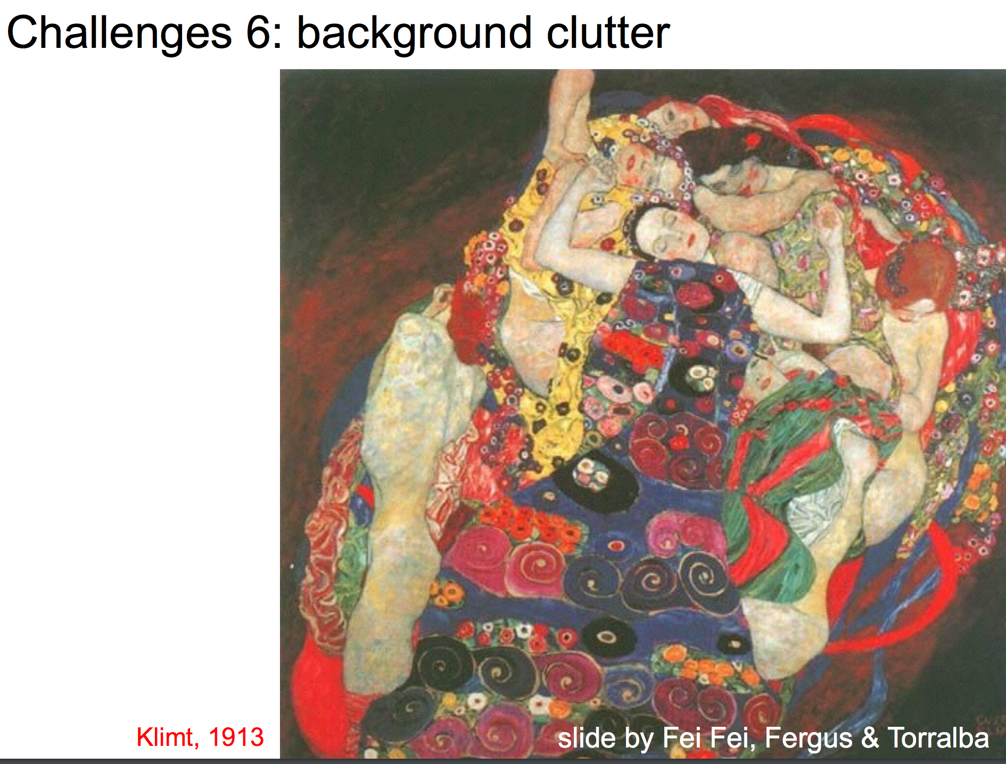
Background clutter

Slide 29
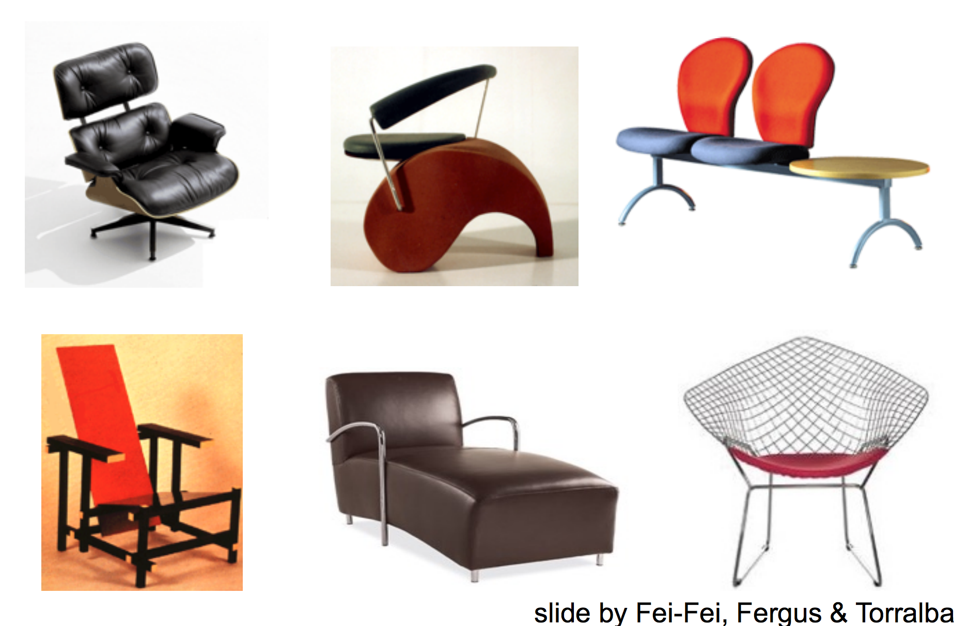
Intra-class variation

Slide 30
What is Visual Recognition?
Image tagging
deer
cat
trees
grass

Slide 31
What is Visual Recognition?
Object detection
deer
cat
trees
grass

Slide 32
What is Visual Recognition?
Object segmentation
deer
cat
trees
grass

Slide 33
What is Visual Recognition?
Physics / Intuition
Gravity
Velocity

Slide 34
Pushing the Limits of Visual Recognition
Reasoning about Language!
a cat is chasing a young deer

Slide 35
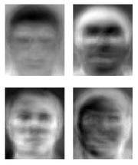
Ridiculously brief history of computer vision
1966: Minsky assigns computer vision as an undergrad summer project
1960’s: interpretation of synthetic worlds
1970’s: some progress on interpreting selected images
1980’s: ANNs come and go; shift toward geometry and increased mathematical rigor
1990’s: face recognition; statistical analysis in vogue
2000’s: broader recognition; large annotated datasets available; video processing starts
2010’s: Deep learning with ConvNets
Guzman ‘68
Ohta Kanade ‘78
Turk and Pentland ‘91
Slide Credit: James Hays

Slide 36
Challenges in Natural Language Processing

Slide 37
Challenges in Natural Language Understanding
The water is clear enough to see fish swimming around in it
84 104 101 32 119 97 116 101 114 32 105 115 32 99 108 101 97 114 32 101 110 111 117 103 104 32 116 111 32 115 101 101 32 102 105 115 104 32 115 119 105 109 109 105 110 103 32 97 114 111 117 110 100 32 105 110 32 105 116 10

Slide 38
Challenges in Natural Language Understanding: Another Example
53‡‡†305))6*;4826)4‡.)4‡);806*;48†8 ¶60))85;;]8*;:‡*8†83(88)5*†;46(;88*96 *?;8)*‡(;485);5*†2:*‡(;4956*2(5*—4)8 ¶8*;4069285);)6†8)4‡‡;1(‡9;48081;8:8‡ 1;48†85;4)485†528806*81(‡9;48;(88;4 (‡?34;48)4‡;161;:188;‡?;
Any idea about what does it mean the text above?

Slide 41
Challenges in Natural Language Understanding: Another Example
53‡‡†305))6*;4826)4‡.)4‡);806*;48†8 agoodglassinthebishopshostelinthede ¶60))85;;]8*;:‡*8†83(88)5*†;46(;88*96 vilsseattwentyonedegreesandthirteenmi *?;8)*‡(;485);5*†2:*‡(;4956*2(5*—4)8 nutesnortheastandbynorthmainbranchse ¶8*;4069285);)6†8)4‡‡;1(‡9;48081;8:8‡ venthlimbeastsideshootfromthelefteyeo 1;48†85;4)485†528806*81(‡9;48;(88;4 fthedeathsheadabeelinefromthetreeth (‡?34;48)4‡;161;:188;‡?; roughtheshotfiftyfeetout

Slide 42
Challenges in Natural Language Understanding: Another Example
A good glass in the bishop's hostel in the devil's seat twenty-one degrees and thirteen minutes northeast and by north main branch seventh limb east side shoot from the left eye of the death's-head a bee line from the tree through the shot fifty feet out.

Slide 43
The Gold-Bug Short story by Edgar Allan Poe,
novelist and famous UVA dropout

Slide 44
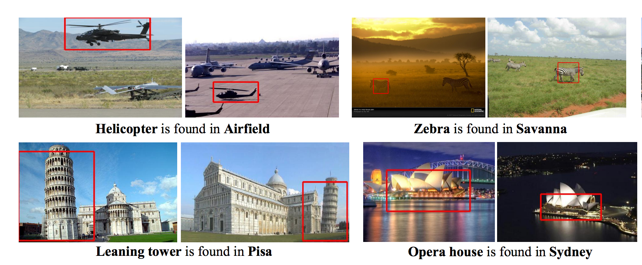
Vision + Language
Knowledge from Images and Text: Chen et al. 2013

Slide 45
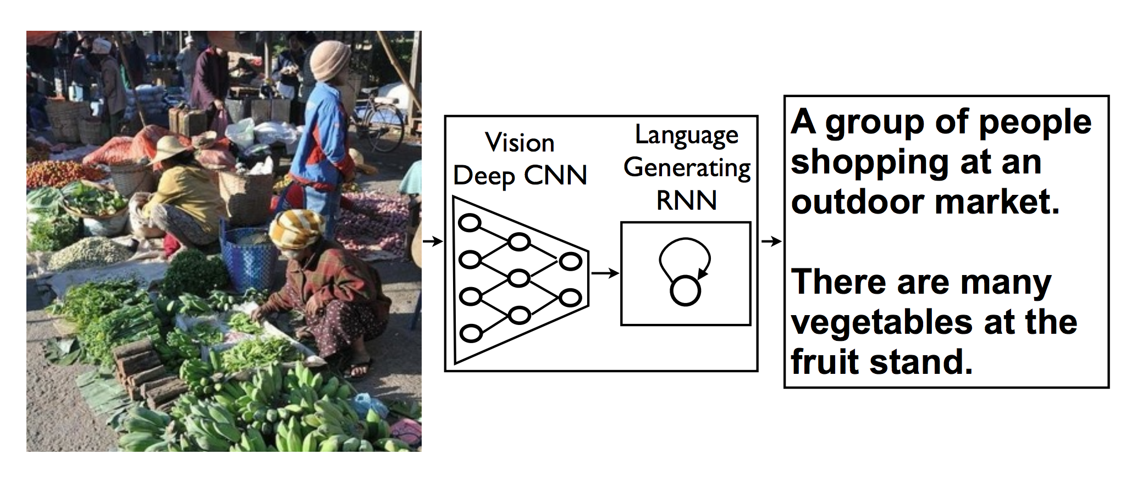
Vision + Language
Caption Generation: Vinyals et al. 2015
Before deep learning became mainstream: Many of my own previous work with my advisor, Ali Farhadi, Julia Hockenmaier, Mirella Lapata, among others

Slide 46
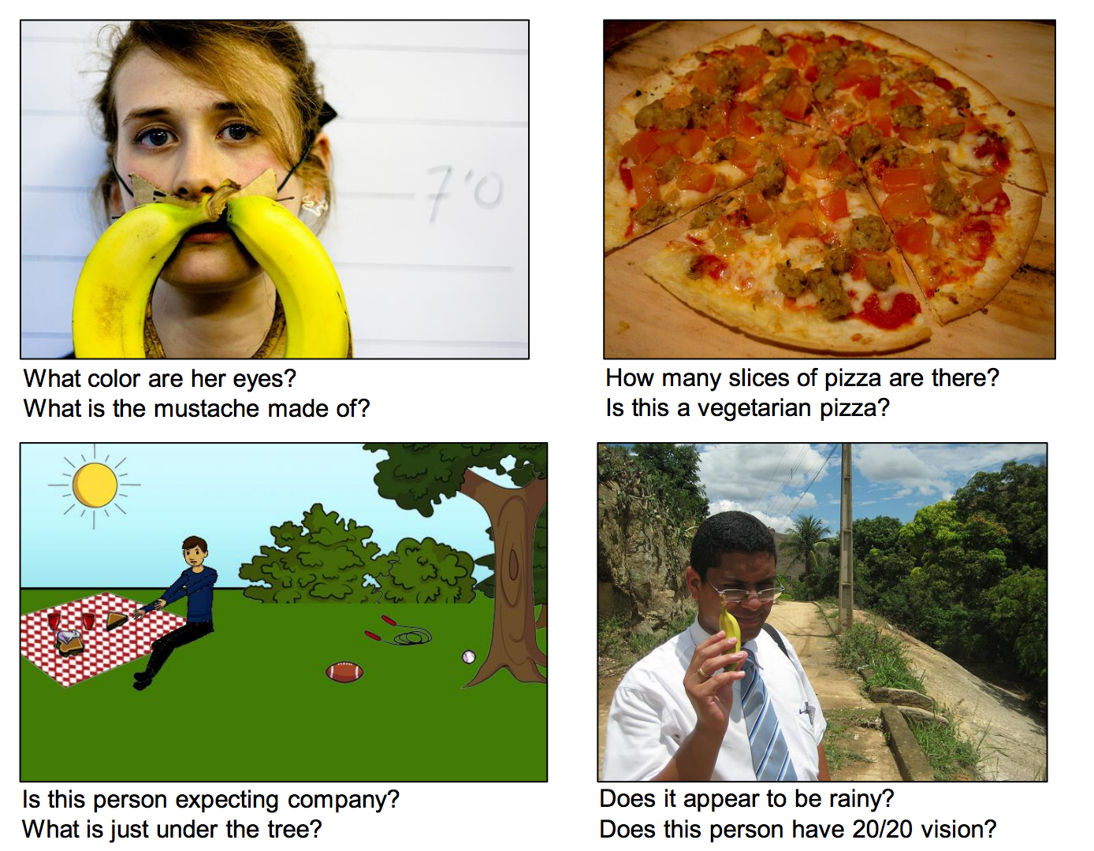
Vision + Language
Visual Question Answering: Agrawal et al. 2015

Slide 47
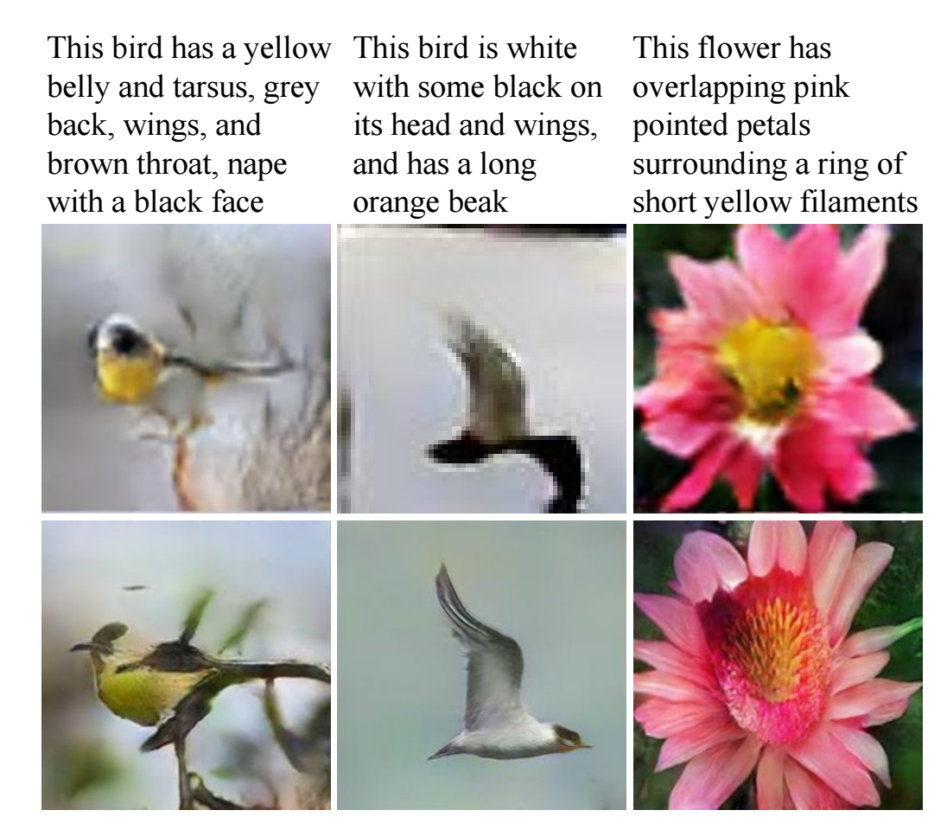
Vision + Language
Text to Images: Zhang et al. 2016

Slide 48
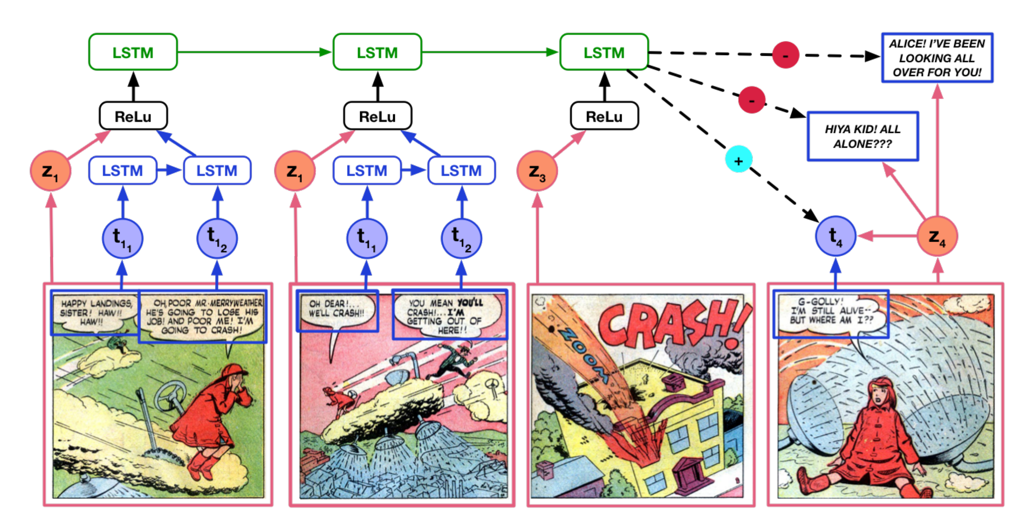
Vision + Language
Fun Stuff: Text + Comic Books: Iyyer et al. 2016

Slide 49
Next Class
More Comprehensive Introduction to Computer Vision and Natural Language Processing.
Also, the Image-Text Retrieval Lab is posted on the course website (Due next week) It is not difficult, but it might take a while to install and compute things. Don’t leave things for the last minute. Any code you write, or answers you give do it in the same Jupyter notebook provided. At the end go to File -> Download as -> HTML. Upload the HTML file to UVA Collab.

Slide 50
Questions?

